Slide 1
SHOP FOR HOME
TEAM MEMBERS:
RAAVI RAJA
MOHANACHARY NANDINI
ADDULAMALA MADHURI
VARANASI MADHURI

Slide 2
PROBLEM STATEMENT
Shop For Home is a popular Store in the market for shopping the home décor stuff . Due to Covid 19 all the offline shopping stopped. So, the store wants to move to the cloud platforms and wants their own web application.

Slide 3
SOFTWARES USED
1) FRONTEND :
Angular
Boot strap
Angular Material
2) BACKEND :
Spring tool suite
Postgresql

Slide 4
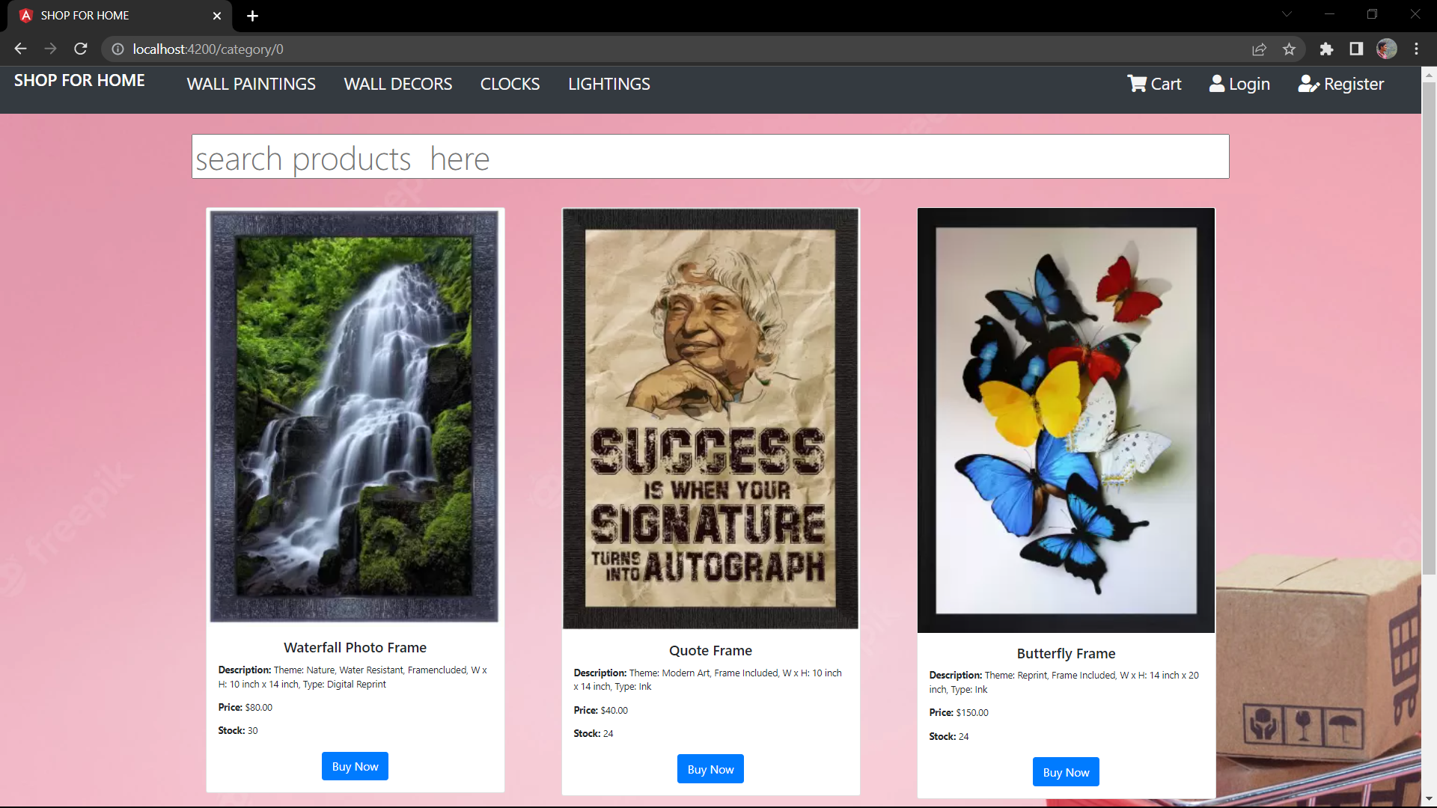
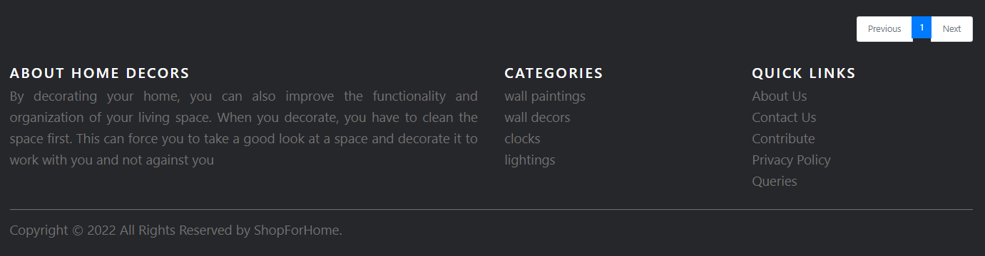
HOME PAGE OF WEBSITE

Slide 5
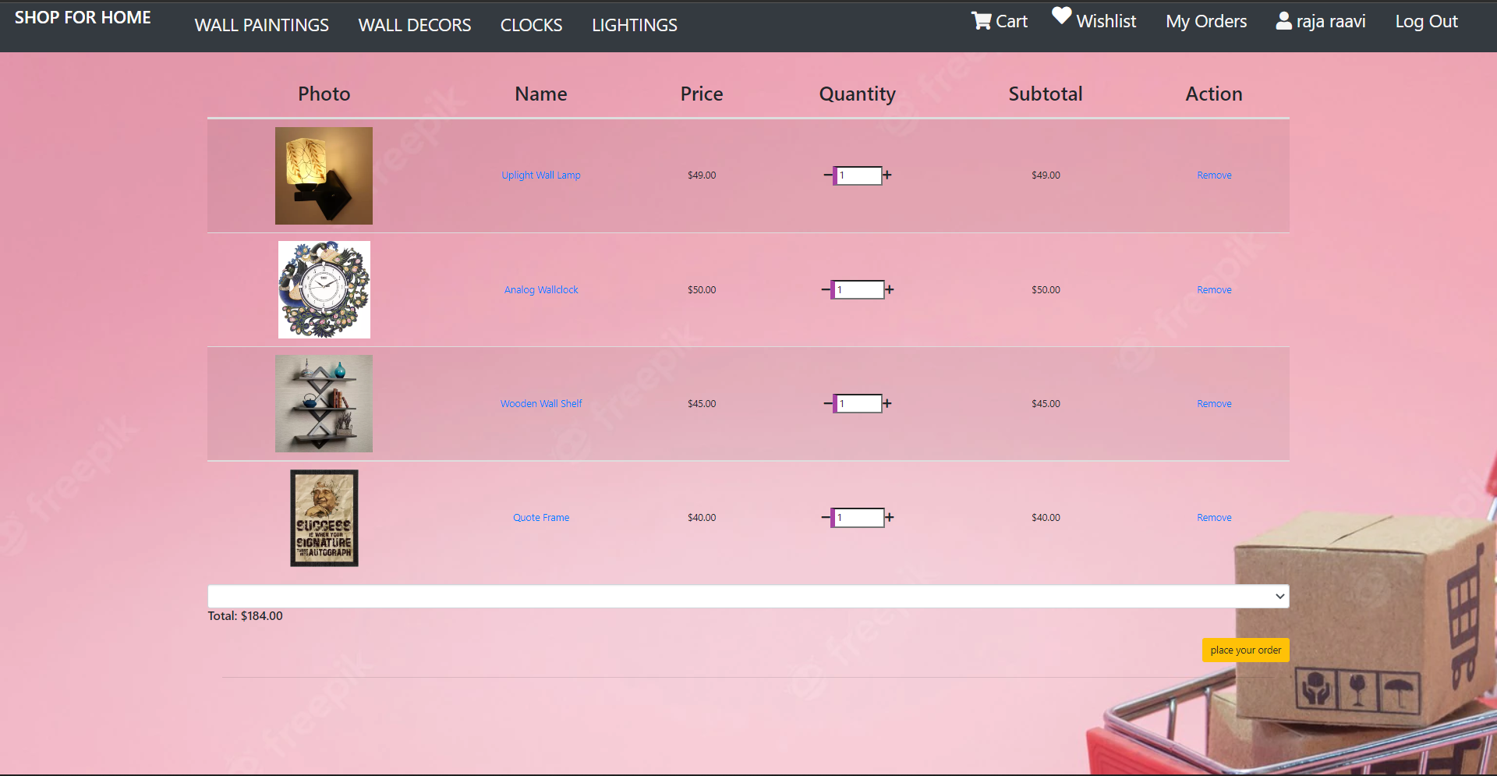
CART OPTION

Slide 6
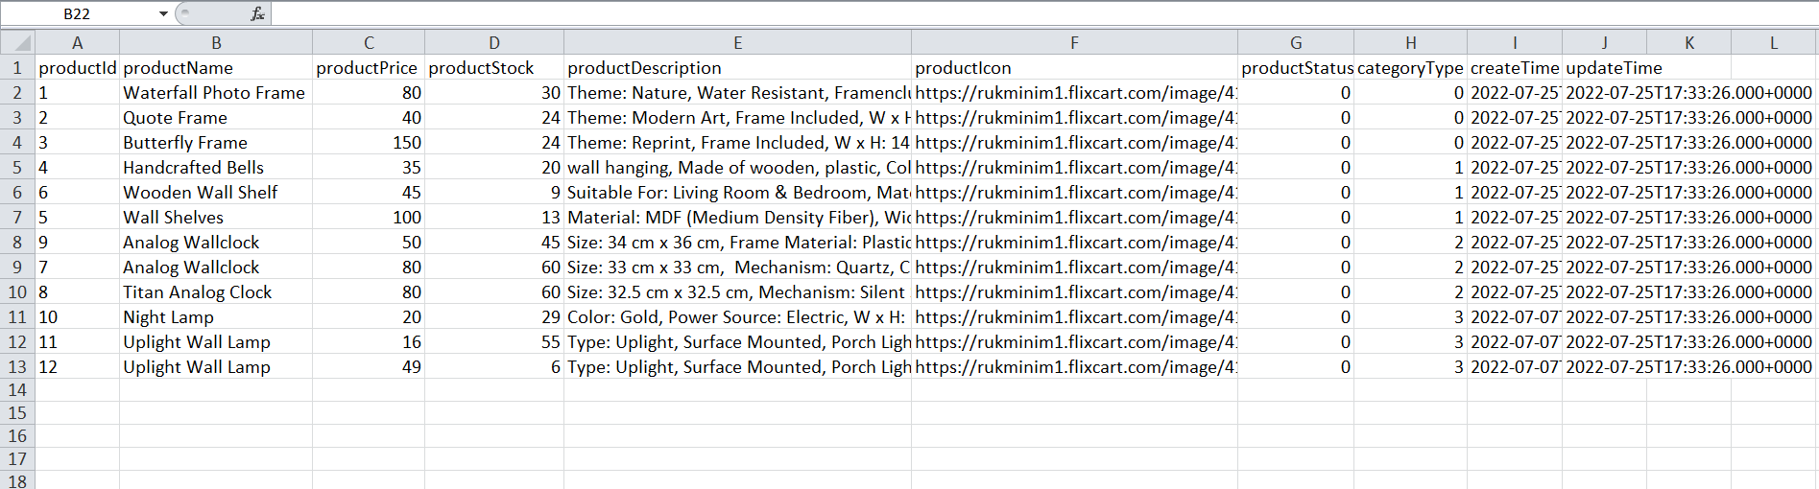
STOCK AND SALES REPORT

Slide 7
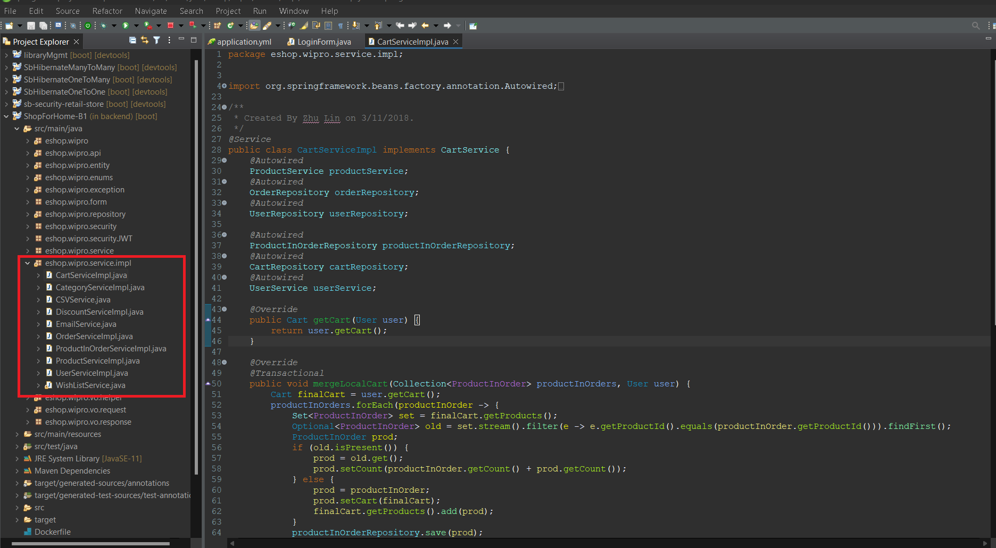
SERVICE LAYER IMPLEMENTATION

Slide 8
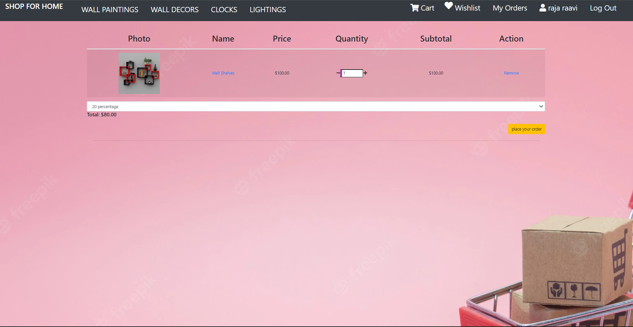
DISCOUNT MICROSERVICE

Slide 9
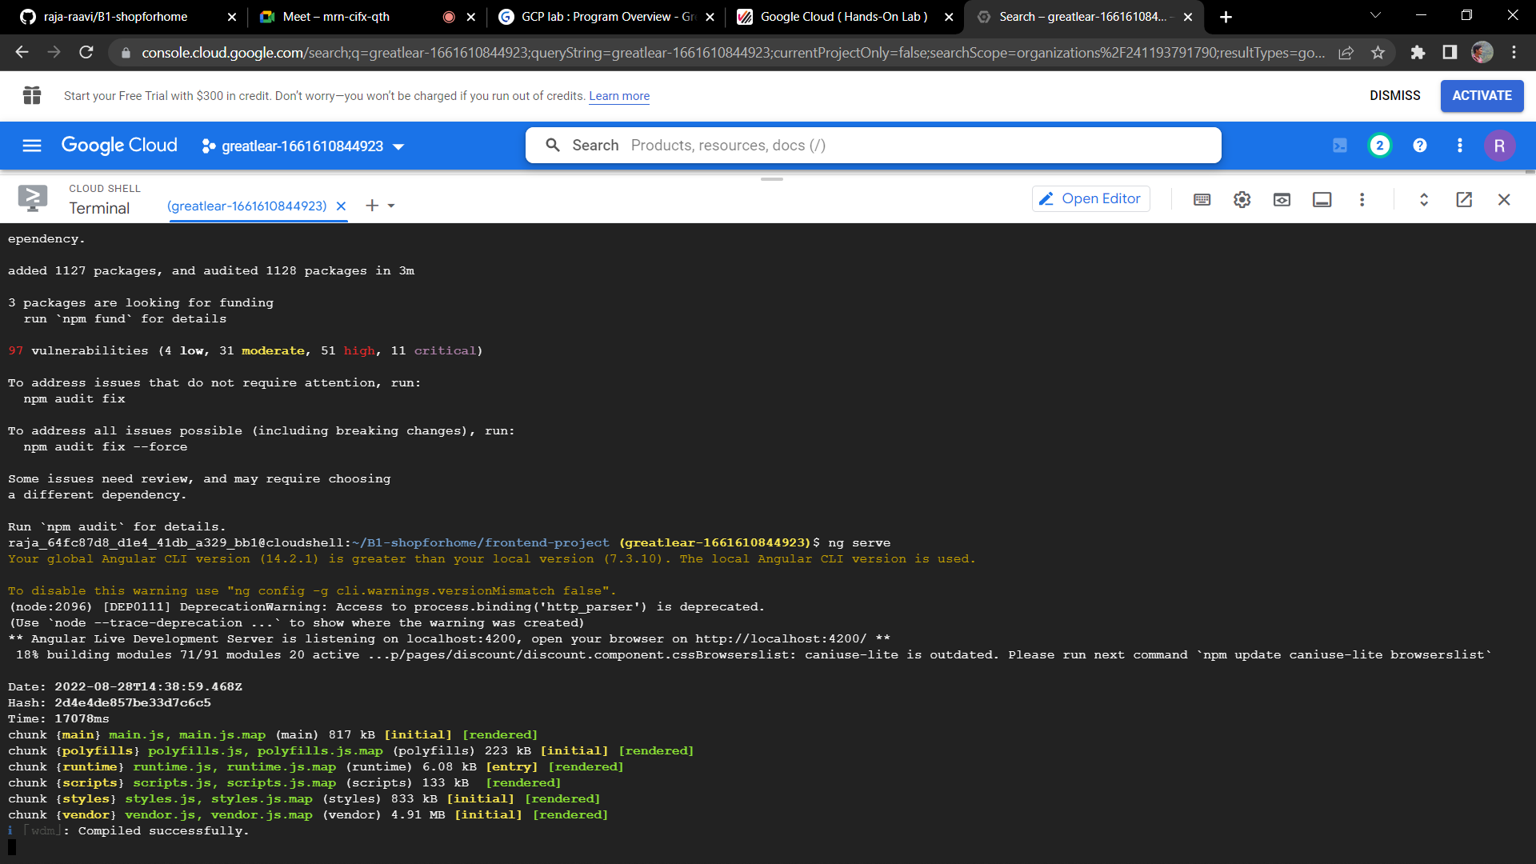
FRONTEND DEPLOYMENT ON VMS

Slide 10
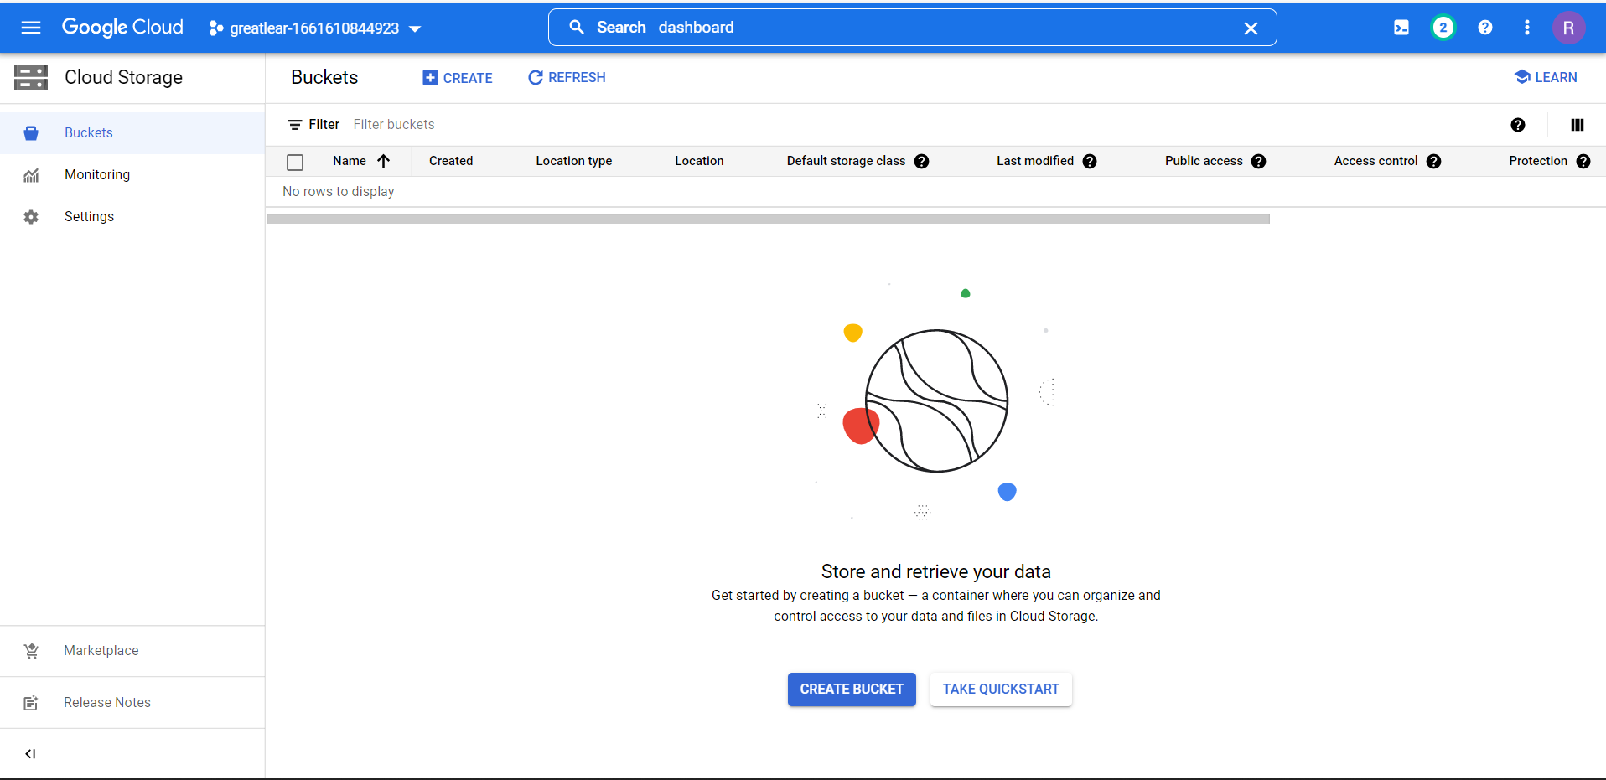
BACKEND DEPLOYMENT ON VMS (CREATING BUCKETS)

Slide 11
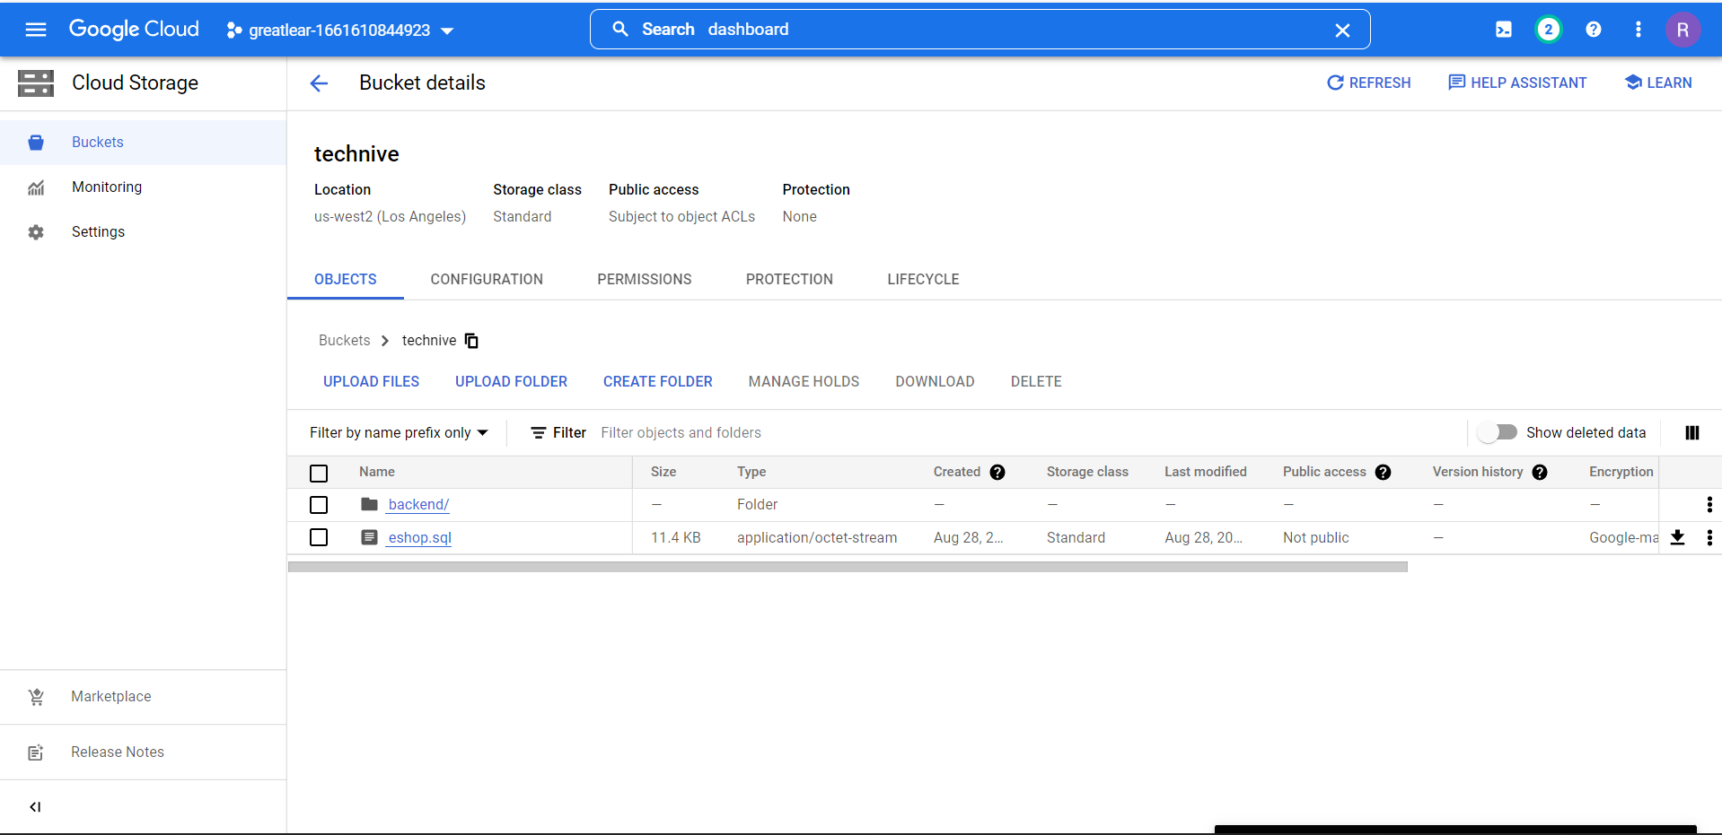
UPLOADING FILES INTO BUKETS (Cont…)

Slide 12
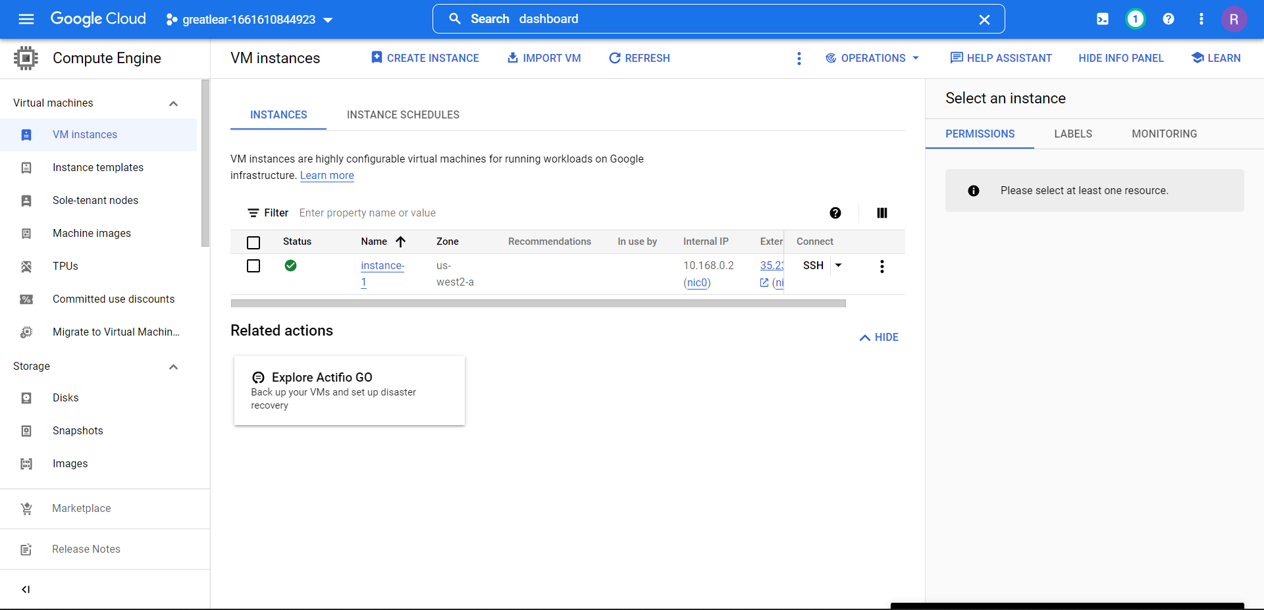

Slide 13
THANK YOU

